Slide 1
AI FOR GOOD · TERM 1 · WEEK 2
Prompt
Coach
Draft
Refine
Reflect
A guided way for beginner students to improve how they ask AI for learning support
Max Lopez · Lovable · UN SDG 4 Quality Education
Notes:
Prompt Coach helps beginners practise writing useful AI prompts without asking the AI to complete their assignment. Introduce the project, Lovable requirement and SDG 4 connection in about 20 seconds.

Slide 2
02
A vague prompt produces generic help
“Help me learn Python.”
WHAT GOES WRONG
The topic stays broad. The learner gives no experience level, boundaries or useful response format.
WHO EXPERIENCES IT
A real draft from the tested example
First-year college and university students beginning to use generative AI for coursework.
Concrete observation
OUTSIDE THE TARGET
In the live test, the coach marked Context, Constraints and Output as not specified.
Advanced prompt writers and students seeking completed assessed work.
Prompt Coach · Hackathon 1
2
Notes:
Use the tested Python example as the evidence required by the rubric. The problem occurs when beginner students formulate coursework prompts before they understand what information an AI system needs. The current tool assumes internet access, English reading ability and basic familiarity with an AI chat interface.

Slide 3
03
The learning loop
The student stays responsible for the revision
01
Draft
Enter a learning goal and first prompt.
02
AI feedback
Lovable analyses Goal, Context, Constraints and Output.
03
Revise
Write a clearer request in your own words.
04
Compare
Lovable names improvements, one gap and one next step.
INPUT
REQUIRED AI STEP
LEARNER ACTION
OUTPUT
Prompt Coach · Hackathon 1
3
Notes:
Walk through the four steps from left to right. Stress that the coach does not prefill the learner's revision. The learner must interpret the feedback and make a change before the second AI comparison.

Slide 4
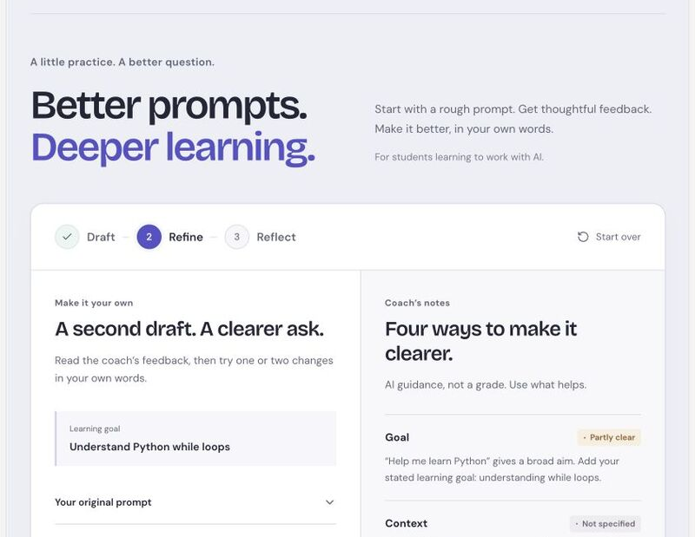
04
Lovable performs a necessary AI step
INPUT
The server receives the learner’s goal and exact draft wording.
AI PROCESS
A server-side function calls Lovable’s AI gateway and requests structured feedback for four prompt dimensions.
WHY IT MATTERS
A static checklist cannot explain what this learner included, what is missing or how two drafts differ.
Prompt Coach · Hackathon 1
4
Notes:
The screenshot comes from the connected Lovable preview after a real AI response on 10 September 2026. The first AI call evaluates the draft. The second compares the original and revision. Codex refined the interface later, but it did not replace Lovable or the Lovable AI gateway.

Slide 5
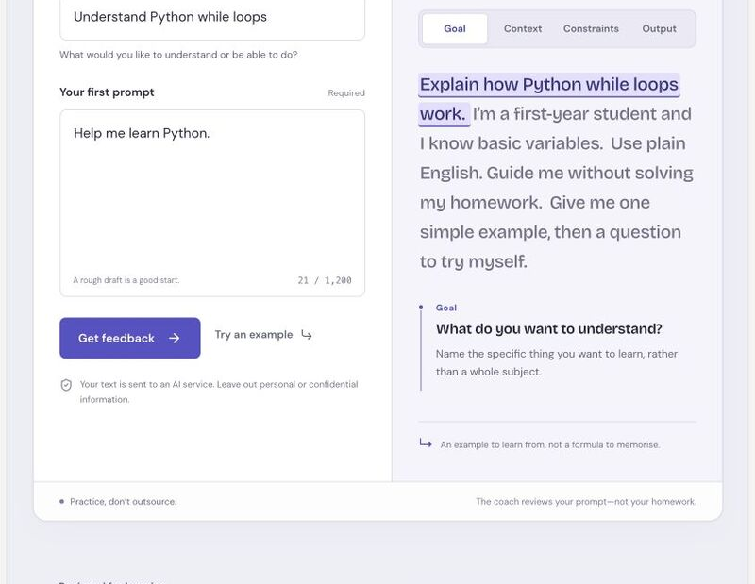
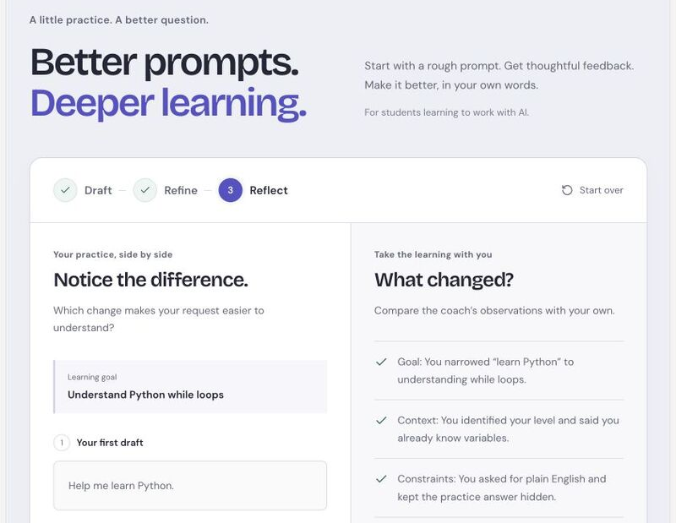
05
Working input and output
INPUT
OUTPUT
Goal + first prompt
Revision + specific comparison
Prompt Coach · Hackathon 1
5
Notes:
These are captures from the connected Lovable preview. The demo uses the draft 'Help me learn Python' and a revision that specifies while loops, learner level, plain English, one short example and a practice question without the answer. The full animated capture is stored in the Week 2 hackathon demo folder.

Slide 6
06
SDG 4: Quality Education
4
The specific issue
Beginner students need practice using AI as a learning aid, not only access to the technology.
WHAT PROMPT COACH ADDS
Guided practice in drafting, revising and reflecting. The student asks for explanations and practice instead of a finished answer.
LIMITS
It does not solve unequal access to devices, connectivity or language support. Its learning effect still needs user testing.
Prompt Coach · Hackathon 1
6
Notes:
UN SDG 4 calls for inclusive and equitable quality education and lifelong learning opportunities. Prompt Coach makes a focused contribution through beginner AI literacy practice. Source: https://sdgs.un.org/goals/goal4

Slide 7
07
Ethical risks, safeguards and next steps
Risk and consequence | What the prototype does now | What should happen next
Incorrect advice A student learns a bad habit or loses confidence. | Labels feedback as guidance, keeps criteria visible and asks for judgment. | Test with students and a teacher. Track recurring errors.
Private data A prompt exposes identity or confidential coursework. | Warns users before submission. Stores no account or in-app history. | Publish retention details and provide a deletion route.
Academic misuse Better prompts could request prohibited work. | Coaches the request, avoids assignment answers and requires a student revision. | Test misuse prompts and review boundaries with a teacher.
Access gap Internet, English or interface barriers exclude learners. | Responsive layout, keyboard controls, live status and reduced motion. | Test screen readers. Add translations and an offline worksheet.
Prompt Coach · Hackathon 1
7
Notes:
Explain one risk in detail if time is short. The important pattern is consequence, current safeguard and a concrete next action. The full reflection is in ETHICAL_REFLECTION.md in the Week 2 hackathon folder.

Slide 8
08
Demo question
Can a beginner improve “Help me learn Python” without receiving the homework answer?
LIVE SEQUENCE
PORTFOLIO EVIDENCE
1 Enter the example
2 Show the four-dimension AI feedback
3 Write the revision and compare both drafts
Term 1 / Week 2 / hackathon
README, product, slides, demo and ethical reflection
github.com/Maxlopez02/ai4g-portfolio-MaxLopez
Prompt Coach · Hackathon 1
8
Notes:
Suggested demo: click Try an example, request feedback, explain one missing dimension, paste the prepared revision, and compare. The captured GIF is a backup if the live AI service is slow. End by stating that the learner did the revision and the coach never answered the homework question.

